Slide 1
No food or drink in the sanctuary. Water is okay.
Please silence your cellphone.

Slide 2
I’ve Got a Right
I've got a right to praise the Lord.
I've got a right to praise the Lord.
I've got a right to clap my hands.
I've got a right to shout, “Amen!”
I've got a right to praise the Lord.

Slide 4
I Am Free
Through You the blind will see.
Through You the mute will sing.
Through You the dead will rise.
Through You our hearts will praise.
Through You the darkness flees.
Through You my heart screams
I am free! I am free!

Slide 5
I Am Free
I am free to run (echo)
I am free to dance (echo)
I am free to live for You (echo)
I am free (echo) I am free (echo)

Slide 6
I Am Free
Through You the kingdom comes.
Through You the battle's won.
Through You I'm not afraid.
Through You the price is paid.
Through You there's victory.
Because of You my heart sings
I am free (echo) I am free (echo)

Slide 8
Freedom Reigns
Where the spirit of the Lord is
there is freedom.
Where the spirit of the Lord is
there is freedom.

Slide 9
Freedom Reigns
When you are tired and you're thirsty
there is freedom.
When you are tired and you're thirsty
there is freedom.

Slide 10
Freedom Reigns
Freedom reigns in this place
with showers of mercy and grace.
Falling on everything. There is freedom.
Jesus reigns in this place
with showers of mercy and grace.
Falling on every face. There is freedom.

Slide 11
Freedom Reigns
I lift my eyes to Jesus. There is freedom.
I lift my eyes to Jesus. There is freedom.

Slide 13
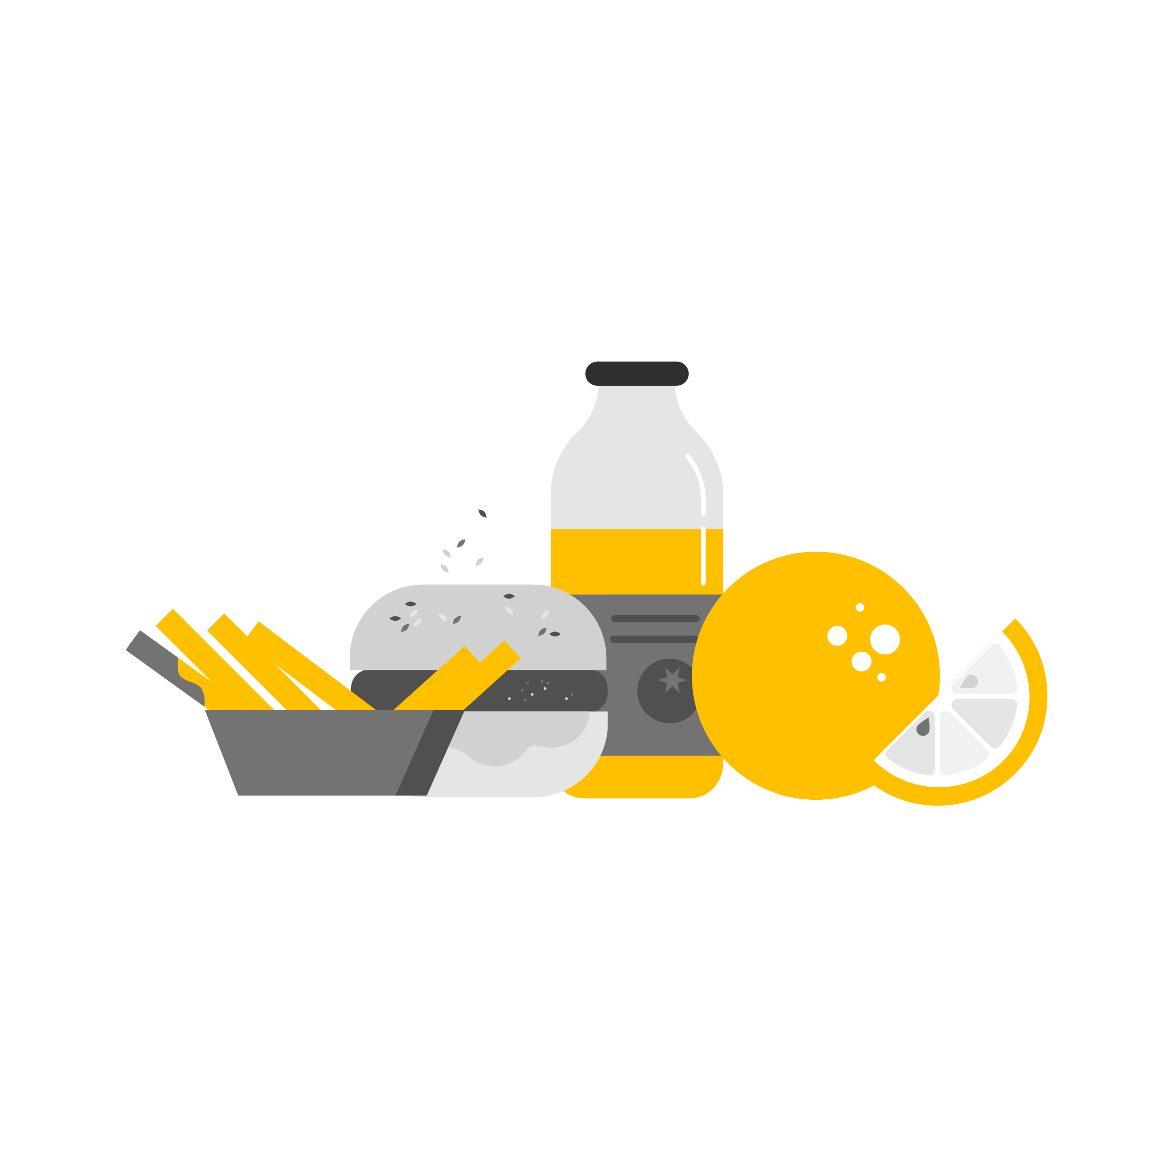
September 14th
Zoom Bible Study @ 7pm
Link on website
September 25th
Quarterly Offering
Snack Shack
September 23rd – 25th
Ladies Retreat
April 3rd
Supports: Youth
September 28th
Neighborhood Market @ 8am
September 24th
Butler’s Pantry @ 8am

