Slide 1
No food or drink in the sanctuary. Water is okay.
Please silence your cellphone.

Slide 2
Because of You
Never before have I felt so alive.
Never before have I thought I could fly.
Never before have I ever been so free.
Being with You I now begin to see,
That Your presence overwhelms me.

Slide 3
Because of You
Because of You I can dance.
Because of You I lift my hands.
Because of You I can sing, “I am free!”
Because of You I can dance.
Because of You I lift my hands.
Because of You I can sing, “I am free!”
Because of You.

Slide 4
Because of You
Never… Never will I go back again
Never… Never will I hold back again.
Never… Never will I hold back again.
Never… Never will I hold back!

Slide 6
It is You
As we lift up our hands, will You meet us here?
As we call on Your name, will You meet us here?
We have come to this place to worship You.
God of mercy and grace

Slide 7
It is You
It is You we adore.
It is You our praises are for.
Only You, the heavens declare it is You, it is You.

Slide 8
It is You
Holy, holy is our God almighty.
Holy, holy is His name alone.
(x2)

Slide 9
It is You
As we lift up our hands
as we call on Your name
will You visit this place
with Your mercy and grace?
(x2)

Slide 11
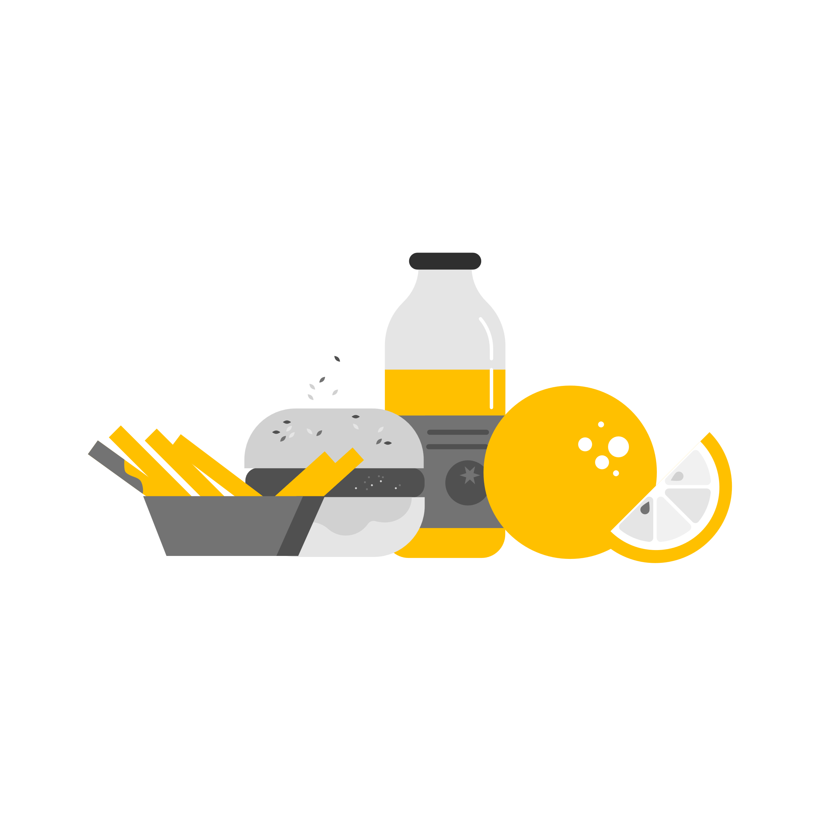
Tue, March 28th
Prayer Meeting @ 9am
Wed, April 27th
Neighborhood Market
@ 8am
Wed, March 29th
Bible Study @ 7pm
Sat, April 29th
Food Distribution @ 8am
Snack Shack
April 3rd
Supports: Youth
Wed, April 5th
Men’s Fellowship @ 9am
butlerpcg.org/events

